Slide 1
Acta Biomaterialia 65 (2018) 36–43
Date: 08/28/18

Slide 2
Introduction
Issues of hydrogel system for macroscale protein drugs delivery
Mesh sizes larger than the size of proteins and not strongly interact with cargo: rapid release of encapsulated cargo by diffusion
Current solution: first loading the protein in another phase (i.e. PLGA microsphere)
Hydrogel crosslinking chemistry:
Ionic crosslinking: limitation of weak mechanical integrity and outward flux of ions from the gel over time
Covalent crosslinking: cross-reactivity with the proteins
Significance
Substantial interaction with proteins: Simply premixes the protein with charged nanoparticles (LaponiteXLG) that bind strongly with the protein
Click chemistry: bio-orthogonal click reaction for hydrogel formation
Protein–laden particles are placed within a hydrogel and released in a control manner
Injectable hydrogel
Notes:
entrapment of proteins in another carriers prior to incorporation into a hydrogel often requires laborious optimization, harsh conditions involving organic solvents, and frequently results in poor encapsulation efﬁciencies
Click chemistry: alternative approach to synthesize covalent bonding; high chemo selectivity and fast reaction
Bioorthogonal chemistry: any chemical reaction that can occur inside of living systems without interfering with native biochemical processes (no need for copper catalyst which is cytotoxic)

Slide 3
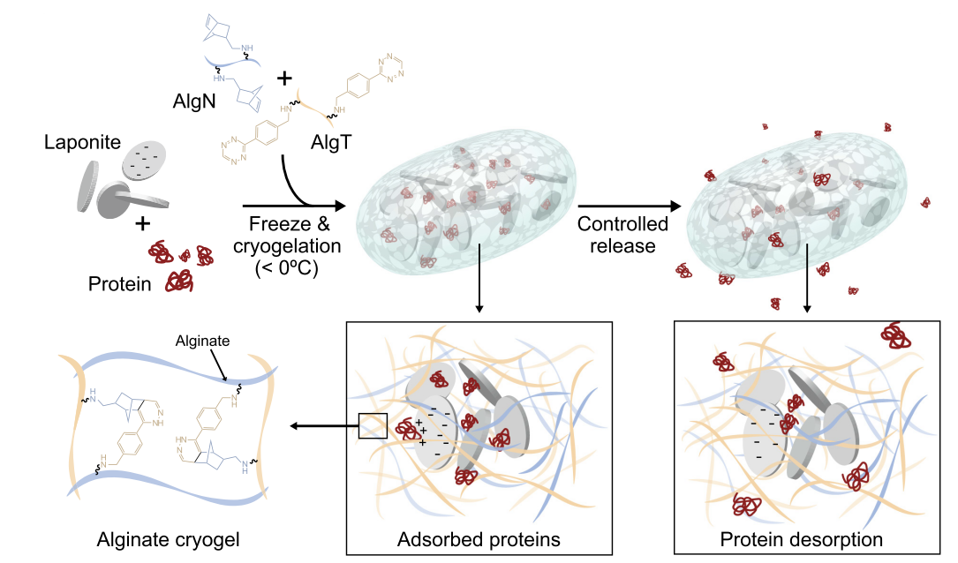
Laponite-containing click alginate cryogels
Laponite: Pre-adsorption of protein cargo
Smectite clay: 25nm diameter and 1nm thickness nanoplatelet
High negative surface charge on their faces
pH-dependent charge on their rim (pH<9)
Notes:
Physical gels formed from the interaction of Laponite with electrolytes have been shown to adsorb and release bioactive proteins
Small molecule drug-> interlayer disc;

Slide 4
Laponite-containing click alginate cryogels
Cryogel: sponge-like injectable preformed scaffolds
Created from cryopolymerization
Shape memory, mechanically robust hydrogel
Macroscale porosity of the gels can be altered by the freezing conditions
The thawed cryogels release the bound protein over time, facilitating controlled release into the surroundings
Notes:
Physical gels formed from the interaction of Laponite with electrolytes have been shown to adsorb and release bioactive proteins
Small molecule drug-> interlayer disc;

Slide 5
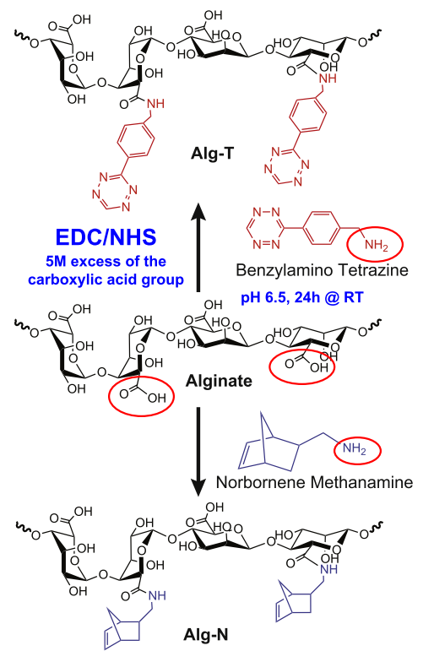
Click alginate hydrogel
1. Click alginate synthesis:
Bio-orthogonal click chemistry
Carbodiimide chemistry: Tetrazine-norbornene conjugation
The degree of substitution was 5% tetrazine or norbornene per alginate chain, determined by ¹H-NMR

Slide 6
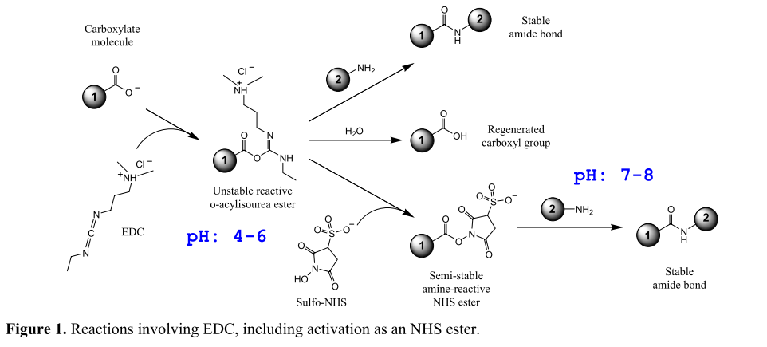
EDC/NHS reaction

Slide 7
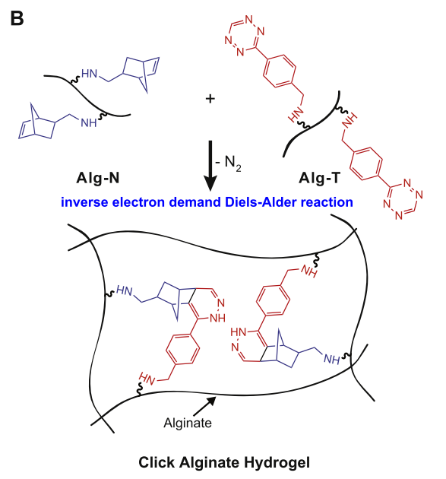
Click alginate hydrogel
2. Cryogel formation:
Bio-orthogonal chemistry: Formation of covalently bonding without damaging cargo
AlgN and AlgT are mixed at a 1:1 ratio, and immediately pipetted into polystyrene molds and placed in a freezer overnight for cryopolymerization
Disperse Laponite XLG (with or without pre-mixing with protein) in the suspension prior to cryogelation
Notes:
The reaction is a cycloaddition between an electron-rich dienophile and an electron-poor diene.
The nitrogen gas evolved from the crosslinking reaction does lead to the formation of a few small bubbles within the hydrogel. A stable gel was formed within 1 h at 25C.

Slide 8
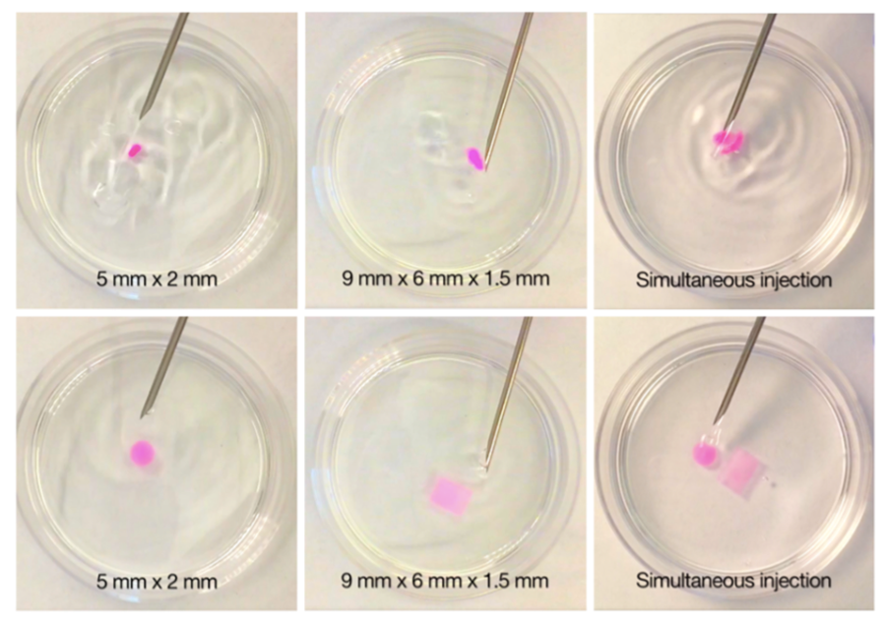
Formation of click alginate cryogels incorporating Laponite
Interconnected porous structure
high deformability
Injectable through a 16 G needle
Notes:
Two frames are shown for each gel demonstrating both initial exit from the needle (top) and resumption of the original gel shape (bottom)
Disc v.s. rectangular shape

Slide 9
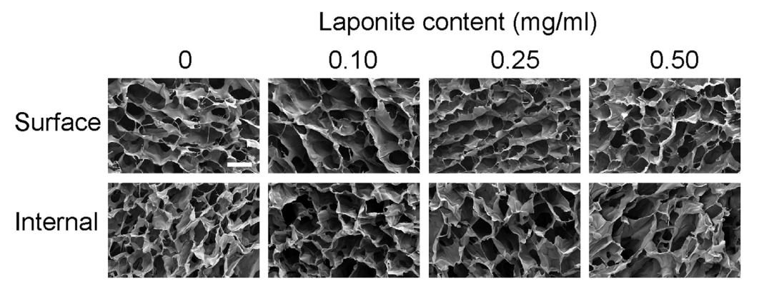
Addition of Laponite prior to cryogelation
Pore size range: 50-300 µm
Notes:
no obvious impact of Laponite addition on pore architecture was seen over this range.

Slide 10
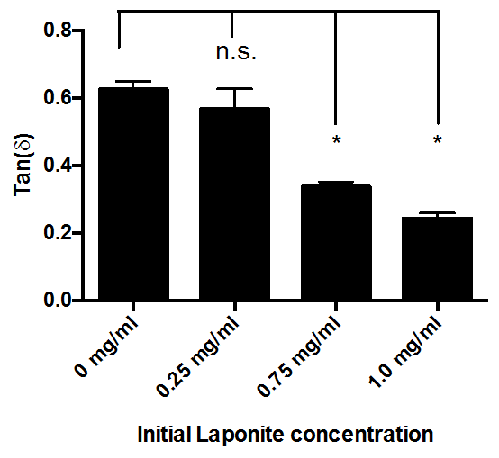
Effect of Laponite concentration on the mechanical properties of the hydrogels
Laponite concentration↑:
Loss modulus↓
Results in brittle gels
Upper limit: 0.5mg/ml
Continuous stiffness measurement (CSM) nanoindentation: energy dissipation of a material under cyclic load
Tan (δ)=loss modulus/storage modulus
Tan (δ)> 1=> more liquid property (viscosity)
Tan (δ)< 1=> more solid property (elasticity)
Notes:
Higher initial concentrations of Laponite resulted in gels that were not reversibly deformable and fragmented when injected.
Viscosity: shear stress/strain rate;
Elastic gel (energy stored in the material): (phase angle=0); viscous liquid (energy dissipated as heat)
When changing strain, tan(delta)=loss modulus/storage modulus=G”/G’
When changing stress, Tan(psi)=elastic stress/viscous stress
Shear modulus: shear stress/strain: G* (complex shear modulus)=G’ (in phase storage modulus)+iG” (out of phase loss modulus)

Slide 11
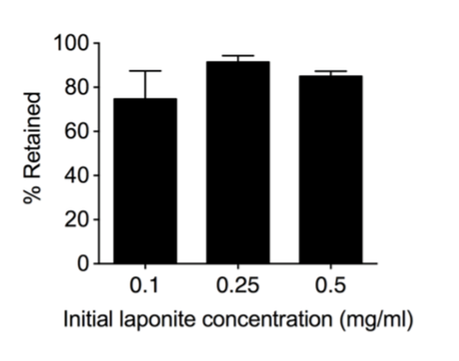
Assessment of Laponite retention within the gels after cryopolymerization and thawing into water for one hour
Analyze silicon content within the gels by ICP-AES (Inductively coupled plasma atomic emission spectrometry )
A large fraction (>70%) of the input Laponite was retained at all of the initial Laponite concentrations tested.

Slide 12
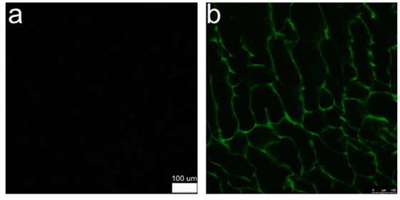
Distribution of Laponite within the walls of cryogel
Visualized using confocal microscopy
Distribution of Alexa Fluor 488-azide-adsorbed Laponite within click alginate cryogels. Cryogels without (a) or with (b) 0.5 mg/ml Laponite were created containing 1.5 ug of Alexa Fluor 488-azide per gel, and washed to remove unbound dye

Slide 13
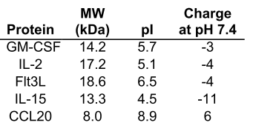
Effect of Laponite on protein release from click alginate cryogels
Five immune-related proteins for immunotherapies
GM-SCF: granulocyte macrophage colony-stimulating factor, a cytokine in oncology. (recruiting DCs)
IL-2: interleukin2, support T cell
FLT3L: FMS-like tyrosine kinase 3 ligand, increases the number of B cells and T cells
IL-15: support T cell expansion
CCL20: strongly chemotactic for lymphocytes

Slide 14
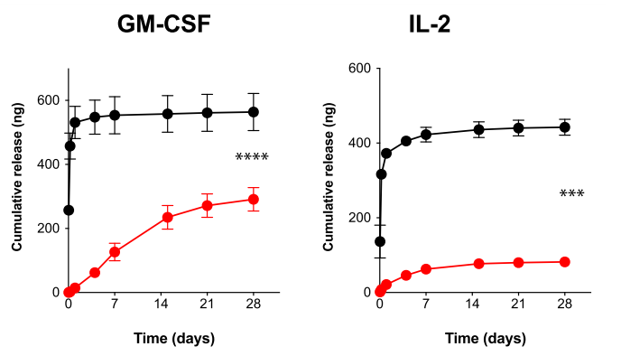
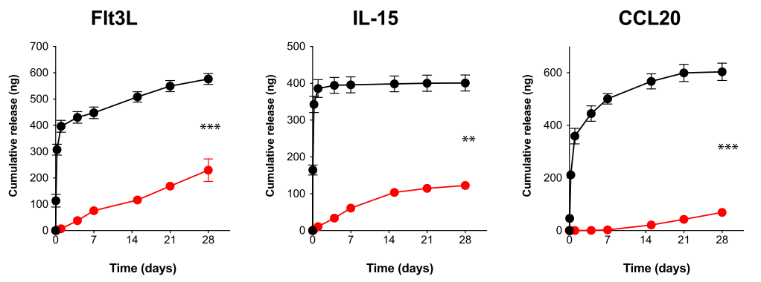
Effect of Laponite on protein release from click alginate cryogels
Made solely from click alginate:
Burst release
Diffusion-dominated drug release system
Incorporation of Laponite
Maintained controlled release over 4 weeks
Protein size was not the key property determining release
1 mg of recombinant protein either in free form, or pre-incubated with 25 mg of Laponite was incorporated in each 50 ml gel.
Supernatants were collected from protein-loaded gels incubated in 1% BSA in DPBS, and the recombinant protein release was assessed by ELISA.
Notes:
1. CCL20 smallest but release slower. protein size was not the key property determining release. (mesh size or tortuosity of the gel, probably charge(the only positive))
2. Injection of newly formed Laponite-containing cryo-gels loaded with 1 mg of GM-CSF through a needle resulted in
the loss of only 3.6 ± 0.9 ng of protein, which is <0.5% of the encap-sulated protein and ~2% of the amount released over the four week period.

Slide 15
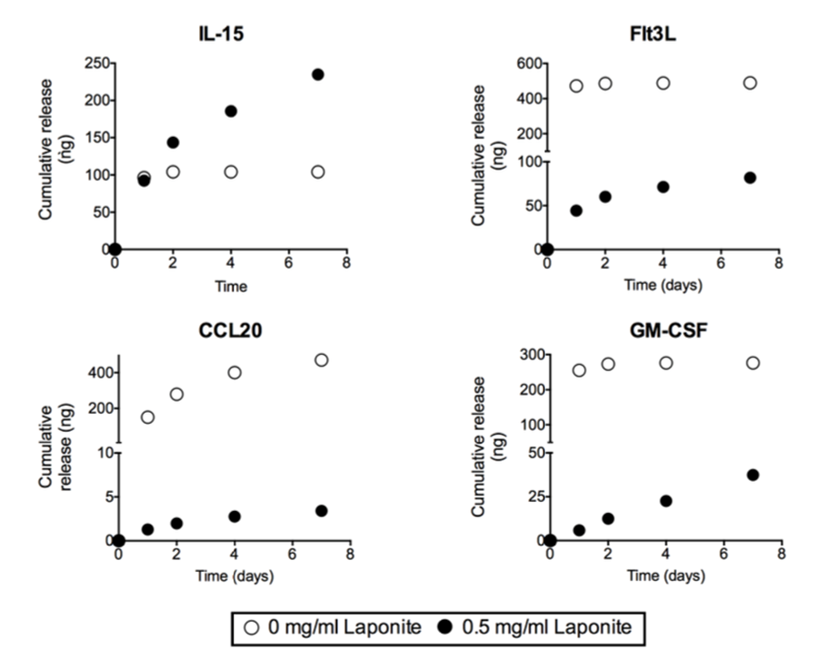
Release of various proteins after post-cryogelation soaking in protein solutions.
Soaking pre-formed Laponite-containing click alginate cryogels in solutions of protein:
Greater absorption of proteins into the gel
Slower release compared to pristine click alginate cryogel
Samples were soaked for 15 minutes in release buffer prior to the initiation of the release study.
Protein release was analyzed by ELISA from the release supernatants.

Slide 16
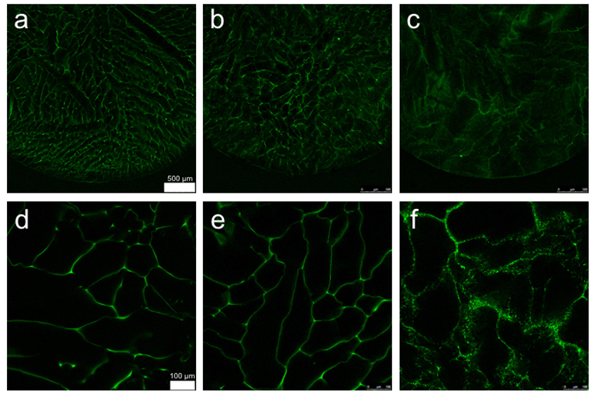
Release of various proteins after post-cryogelation soaking in protein solutions
0.5mg/ml Laponite
0.5mg/ml Laponite w/ 2x DPBS
w/o Laponite
After wash

Slide 17
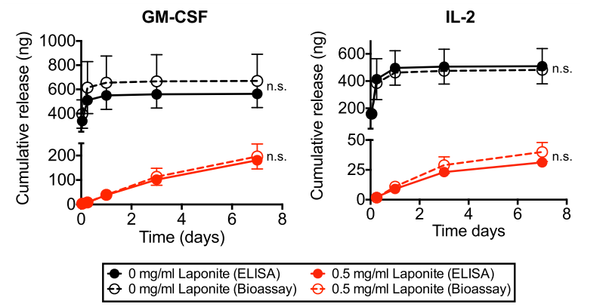
Protein bioactivity after release from cryogels
The results showed no signiﬁcant difference from the values measured by ELISA for cryogels with and without Laponite
Supernatants were collected with from gels incubated in 1% BSA in DPBS, and the recombinant protein release was assessed by ELISA.
In parallel, samples were used in cell based proliferation assays with mouse bone marrow cells or CTLL-2 cells for GM-CSF and IL-2, respectively, to determine bioactivity
Notes:
These two are choosing: clinically used for immunotherapy in human
Measure metabolic activity (5 days incubation) CTLL2 T cell origin, used to determine the amount of cytokine

Slide 18
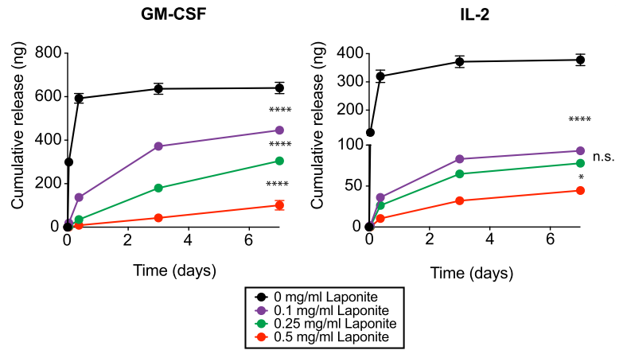
Tuning protein release from cryogels by varying Laponite content
Increasing the amount of Laponite used for pre-adsorption of proteins:
Reduced burst release
Slowed the elution of proteins over time from the gels

Slide 19
Conclusions
The incorporation of Laponite XLG into hydrogels containing encapsulated proteins was demonstrated to slow protein release.
The release kinetics of proteins from the gels could be tuned by varying the Laponite content within the gels.
Comments:
Results in figure 4 didn’t match the description (protein bioactivity)
Hydrogel degradation over time could be evaluated.

